Slide 1
La catastrofe italiana
dei tagli di investimento sulla scuola negli ultimi 15 anni
Comitato a sostegno della
www.lipscuola.it
Notes:
3-D rebounding text
(Intermediate)
To reproduce the text effects on this slide, do the following:
On the Home tab, in the Slides group, click Layout, and then click Blank.
On the Insert tab, in the Text group, click Text Box.
Drag to draw a text box on the slide.
In the text box, enter text and select it.
On the Home tab, and then in the Font group do the following:
In the Font list select Corbel.
In the Font Size box enter 50 pt.
Click Bold.
On the Home tab, in the Paragraph group, click Center.
Select the text box on the slide.
Under Drawing Tools, on the Format tab, in the WordArt Styles group, click More WordArt, and under Applies to All Text in Shape select Fill, - Accent 1, Plastic Bevel, Reflection (first row, the fifth option from the left).
To reproduce the animation effects on this slide, do the following:
Tip: If necessary, zoom out from the slide in Normal View to reproduce the animation effects. To zoom out from the slide, on the View tab, in the Zoom group, click Zoom, and then in the Zoom dialog box, under Zoom out click 66%.
Select the text box. On the Animations tab, in the Advanced Animation group, click Add Animation, and then under Entrance click Fade.
Also on the Animations tab, in the Timing group, do the following:
In the Start list, select With Previous.
In the Duration list, enter 1.00.
Also on the Animations tab, in the Advanced Animation group, click Add Animation, and then under Motion Path click Custom Path. On the slide press and hold SHIFT, and then do the following:
Click the in the center of the text box.
On the right edge of the text box, click the second point.
Two inches beyond the left edge of the slide, double-click the third point.
On the Animations tab, in the Timing group, do the following:
In the Start list, select With Previous.
In the Duration box, select 2.00.
On the slide, right-click the motion path on the slide, and select Reverse Path Direction.
To reproduce the background effects on this slide, do the following:
Right-click the slide background area, and then click Format Background. In the Format Background dialog box, click Fill in the left pane, select Gradient fill in the Fill pane, and then do the following:
In the Type list, select Radial.
Click the button next to Direction, and then click From Center (first row, second option from the left).
Under Gradient stops, click Add gradient stop or Remove gradient stop until two stops appear in the slider.
Also under Gradient stops, customize the gradient stops that you added as follows:
Select the first stop in the slider, and then do the following:
In the Position box, enter 0%.
Click the button next to Color, and then under Theme Colors select White, Background 1 (first row, first option from the left).
Select the last stop in the slider, and then do the following:
In the Position box, enter 100%.
Click the button next to Color, and then under Theme Colors, click More Colors, and then in the Colors dialog box, on the Custom tab enter values for Red: 200, Green: 209, and Blue: 218.

Slide 2
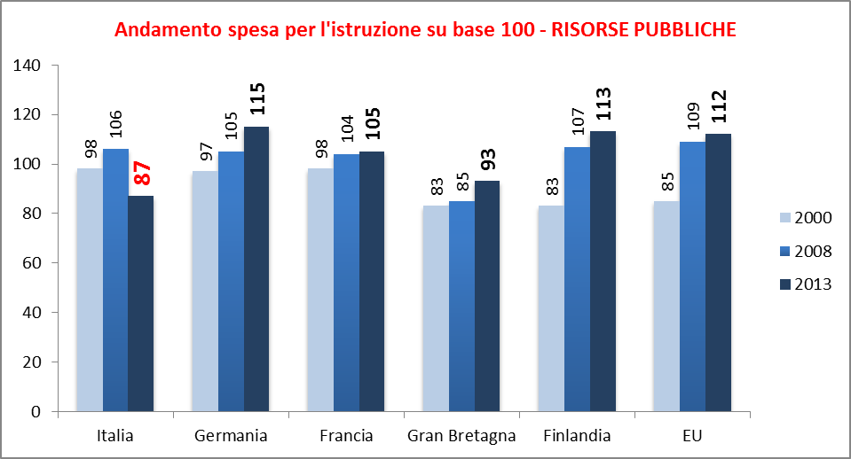
Gli investimenti pubblici in Europa si mantengono alti nonostante la crisi, in Italia calano vistosamente. In Europa: + 27% in 13 anni, + 3% negli ultimi 5 sotto la crisi. In Italia si osserva un calo vistoso: -11% in 13 anni e -19% negli ultimi 5 anni dopo il picco positivo del 2008. Gli investimenti pubblici in istruzione diventano i più bassi in Europa: -25% della media EU. L’Italia spendeva nel 2000 il 13% in più della media europea, nel 2013 spende il 25% di meno ed è il paese che spende meno fra quelli più sviluppati.
Fonti: Oecd 2014, Eurydice 2013
Notes:
3-D rebounding text
(Intermediate)
To reproduce the text effects on this slide, do the following:
On the Home tab, in the Slides group, click Layout, and then click Blank.
On the Insert tab, in the Text group, click Text Box.
Drag to draw a text box on the slide.
In the text box, enter text and select it.
On the Home tab, and then in the Font group do the following:
In the Font list select Corbel.
In the Font Size box enter 50 pt.
Click Bold.
On the Home tab, in the Paragraph group, click Center.
Select the text box on the slide.
Under Drawing Tools, on the Format tab, in the WordArt Styles group, click More WordArt, and under Applies to All Text in Shape select Fill, - Accent 1, Plastic Bevel, Reflection (first row, the fifth option from the left).
To reproduce the animation effects on this slide, do the following:
Tip: If necessary, zoom out from the slide in Normal View to reproduce the animation effects. To zoom out from the slide, on the View tab, in the Zoom group, click Zoom, and then in the Zoom dialog box, under Zoom out click 66%.
Select the text box. On the Animations tab, in the Advanced Animation group, click Add Animation, and then under Entrance click Fade.
Also on the Animations tab, in the Timing group, do the following:
In the Start list, select With Previous.
In the Duration list, enter 1.00.
Also on the Animations tab, in the Advanced Animation group, click Add Animation, and then under Motion Path click Custom Path. On the slide press and hold SHIFT, and then do the following:
Click the in the center of the text box.
On the right edge of the text box, click the second point.
Two inches beyond the left edge of the slide, double-click the third point.
On the Animations tab, in the Timing group, do the following:
In the Start list, select With Previous.
In the Duration box, select 2.00.
On the slide, right-click the motion path on the slide, and select Reverse Path Direction.
To reproduce the background effects on this slide, do the following:
Right-click the slide background area, and then click Format Background. In the Format Background dialog box, click Fill in the left pane, select Gradient fill in the Fill pane, and then do the following:
In the Type list, select Radial.
Click the button next to Direction, and then click From Center (first row, second option from the left).
Under Gradient stops, click Add gradient stop or Remove gradient stop until two stops appear in the slider.
Also under Gradient stops, customize the gradient stops that you added as follows:
Select the first stop in the slider, and then do the following:
In the Position box, enter 0%.
Click the button next to Color, and then under Theme Colors select White, Background 1 (first row, first option from the left).
Select the last stop in the slider, and then do the following:
In the Position box, enter 100%.
Click the button next to Color, and then under Theme Colors, click More Colors, and then in the Colors dialog box, on the Custom tab enter values for Red: 200, Green: 209, and Blue: 218.

Slide 3
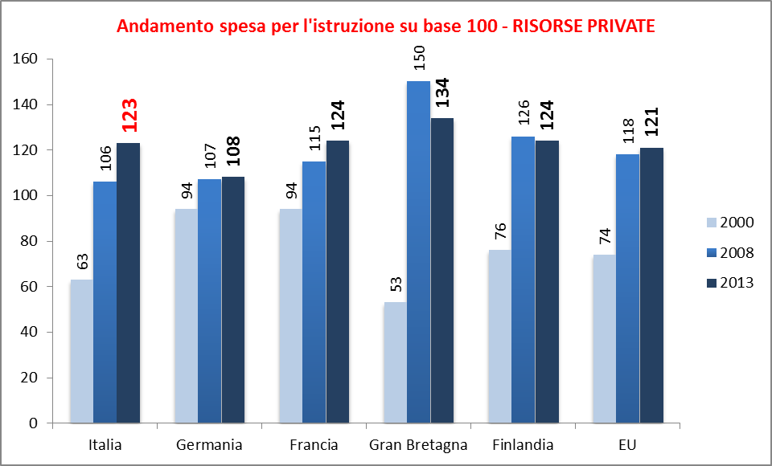
In Europa si osserva un costante aumento degli investimenti privati.
in Italia la spesa per istruzione delle famiglie raddoppia in 11 anni e cresce del 17% negli ultimi 3 anni.
La spesa privata in Italia che era nettamente più bassa della media si è allineata a quella degli altri paesi.
Con spesa privata si intende tutta quella fatta da privati, in Italia questa deriva per lo più dalla spesa famigliare che ha sopperito parzialmente al calo di investimenti pubblici.
Fonti: Oecd 2014, Eurydice 2013
Notes:
3-D rebounding text
(Intermediate)
To reproduce the text effects on this slide, do the following:
On the Home tab, in the Slides group, click Layout, and then click Blank.
On the Insert tab, in the Text group, click Text Box.
Drag to draw a text box on the slide.
In the text box, enter text and select it.
On the Home tab, and then in the Font group do the following:
In the Font list select Corbel.
In the Font Size box enter 50 pt.
Click Bold.
On the Home tab, in the Paragraph group, click Center.
Select the text box on the slide.
Under Drawing Tools, on the Format tab, in the WordArt Styles group, click More WordArt, and under Applies to All Text in Shape select Fill, - Accent 1, Plastic Bevel, Reflection (first row, the fifth option from the left).
To reproduce the animation effects on this slide, do the following:
Tip: If necessary, zoom out from the slide in Normal View to reproduce the animation effects. To zoom out from the slide, on the View tab, in the Zoom group, click Zoom, and then in the Zoom dialog box, under Zoom out click 66%.
Select the text box. On the Animations tab, in the Advanced Animation group, click Add Animation, and then under Entrance click Fade.
Also on the Animations tab, in the Timing group, do the following:
In the Start list, select With Previous.
In the Duration list, enter 1.00.
Also on the Animations tab, in the Advanced Animation group, click Add Animation, and then under Motion Path click Custom Path. On the slide press and hold SHIFT, and then do the following:
Click the in the center of the text box.
On the right edge of the text box, click the second point.
Two inches beyond the left edge of the slide, double-click the third point.
On the Animations tab, in the Timing group, do the following:
In the Start list, select With Previous.
In the Duration box, select 2.00.
On the slide, right-click the motion path on the slide, and select Reverse Path Direction.
To reproduce the background effects on this slide, do the following:
Right-click the slide background area, and then click Format Background. In the Format Background dialog box, click Fill in the left pane, select Gradient fill in the Fill pane, and then do the following:
In the Type list, select Radial.
Click the button next to Direction, and then click From Center (first row, second option from the left).
Under Gradient stops, click Add gradient stop or Remove gradient stop until two stops appear in the slider.
Also under Gradient stops, customize the gradient stops that you added as follows:
Select the first stop in the slider, and then do the following:
In the Position box, enter 0%.
Click the button next to Color, and then under Theme Colors select White, Background 1 (first row, first option from the left).
Select the last stop in the slider, and then do the following:
In the Position box, enter 100%.
Click the button next to Color, and then under Theme Colors, click More Colors, and then in the Colors dialog box, on the Custom tab enter values for Red: 200, Green: 209, and Blue: 218.

Slide 4
In sintesi i costi dell’istruzione, che dovrebbe essere gratuita, (art. 34 c.2) si sono progressivamente scaricati sulle famiglie.
Basti pensare a quanti sono stati costretti ad accedere alle scuole dell’infanzia private per carenza di offerta pubblica,
e al trasformarsi del contributo volontario alle scuole in obbligatorio,
all’aumento del costo dei libri di testo,
al taglio dei fondi per il diritto allo studio.
Notes:
3-D rebounding text
(Intermediate)
To reproduce the text effects on this slide, do the following:
On the Home tab, in the Slides group, click Layout, and then click Blank.
On the Insert tab, in the Text group, click Text Box.
Drag to draw a text box on the slide.
In the text box, enter text and select it.
On the Home tab, and then in the Font group do the following:
In the Font list select Corbel.
In the Font Size box enter 50 pt.
Click Bold.
On the Home tab, in the Paragraph group, click Center.
Select the text box on the slide.
Under Drawing Tools, on the Format tab, in the WordArt Styles group, click More WordArt, and under Applies to All Text in Shape select Fill, - Accent 1, Plastic Bevel, Reflection (first row, the fifth option from the left).
To reproduce the animation effects on this slide, do the following:
Tip: If necessary, zoom out from the slide in Normal View to reproduce the animation effects. To zoom out from the slide, on the View tab, in the Zoom group, click Zoom, and then in the Zoom dialog box, under Zoom out click 66%.
Select the text box. On the Animations tab, in the Advanced Animation group, click Add Animation, and then under Entrance click Fade.
Also on the Animations tab, in the Timing group, do the following:
In the Start list, select With Previous.
In the Duration list, enter 1.00.
Also on the Animations tab, in the Advanced Animation group, click Add Animation, and then under Motion Path click Custom Path. On the slide press and hold SHIFT, and then do the following:
Click the in the center of the text box.
On the right edge of the text box, click the second point.
Two inches beyond the left edge of the slide, double-click the third point.
On the Animations tab, in the Timing group, do the following:
In the Start list, select With Previous.
In the Duration box, select 2.00.
On the slide, right-click the motion path on the slide, and select Reverse Path Direction.
To reproduce the background effects on this slide, do the following:
Right-click the slide background area, and then click Format Background. In the Format Background dialog box, click Fill in the left pane, select Gradient fill in the Fill pane, and then do the following:
In the Type list, select Radial.
Click the button next to Direction, and then click From Center (first row, second option from the left).
Under Gradient stops, click Add gradient stop or Remove gradient stop until two stops appear in the slider.
Also under Gradient stops, customize the gradient stops that you added as follows:
Select the first stop in the slider, and then do the following:
In the Position box, enter 0%.
Click the button next to Color, and then under Theme Colors select White, Background 1 (first row, first option from the left).
Select the last stop in the slider, and then do the following:
In the Position box, enter 100%.
Click the button next to Color, and then under Theme Colors, click More Colors, and then in the Colors dialog box, on the Custom tab enter values for Red: 200, Green: 209, and Blue: 218.

Slide 5
Il piano scuola del governo Renzi intende istituzionalizzare questo fenomeno con l’affermazione che:
“Le risorse pubbli­che non saranno mai sufficienti a colmare le esigenze di investimenti nella nostra scuola.” L’istruzione sta diventando in Italia più che negli altri paesi europei sempre di più una merce da comprare sul mercato e sempre meno un diritto primario che garantisce l’uguaglianza delle opportunità fra i cittadini, come è stato fino a 10 anni fa.
Notes:
3-D rebounding text
(Intermediate)
To reproduce the text effects on this slide, do the following:
On the Home tab, in the Slides group, click Layout, and then click Blank.
On the Insert tab, in the Text group, click Text Box.
Drag to draw a text box on the slide.
In the text box, enter text and select it.
On the Home tab, and then in the Font group do the following:
In the Font list select Corbel.
In the Font Size box enter 50 pt.
Click Bold.
On the Home tab, in the Paragraph group, click Center.
Select the text box on the slide.
Under Drawing Tools, on the Format tab, in the WordArt Styles group, click More WordArt, and under Applies to All Text in Shape select Fill, - Accent 1, Plastic Bevel, Reflection (first row, the fifth option from the left).
To reproduce the animation effects on this slide, do the following:
Tip: If necessary, zoom out from the slide in Normal View to reproduce the animation effects. To zoom out from the slide, on the View tab, in the Zoom group, click Zoom, and then in the Zoom dialog box, under Zoom out click 66%.
Select the text box. On the Animations tab, in the Advanced Animation group, click Add Animation, and then under Entrance click Fade.
Also on the Animations tab, in the Timing group, do the following:
In the Start list, select With Previous.
In the Duration list, enter 1.00.
Also on the Animations tab, in the Advanced Animation group, click Add Animation, and then under Motion Path click Custom Path. On the slide press and hold SHIFT, and then do the following:
Click the in the center of the text box.
On the right edge of the text box, click the second point.
Two inches beyond the left edge of the slide, double-click the third point.
On the Animations tab, in the Timing group, do the following:
In the Start list, select With Previous.
In the Duration box, select 2.00.
On the slide, right-click the motion path on the slide, and select Reverse Path Direction.
To reproduce the background effects on this slide, do the following:
Right-click the slide background area, and then click Format Background. In the Format Background dialog box, click Fill in the left pane, select Gradient fill in the Fill pane, and then do the following:
In the Type list, select Radial.
Click the button next to Direction, and then click From Center (first row, second option from the left).
Under Gradient stops, click Add gradient stop or Remove gradient stop until two stops appear in the slider.
Also under Gradient stops, customize the gradient stops that you added as follows:
Select the first stop in the slider, and then do the following:
In the Position box, enter 0%.
Click the button next to Color, and then under Theme Colors select White, Background 1 (first row, first option from the left).
Select the last stop in the slider, and then do the following:
In the Position box, enter 100%.
Click the button next to Color, and then under Theme Colors, click More Colors, and then in the Colors dialog box, on the Custom tab enter values for Red: 200, Green: 209, and Blue: 218.

Slide 6
Il disimpegno nei confronti dell’istruzione pubblica è confermato dalla Legge di stabilità
Supplenze brevi personale tecnico e amministrativo: - 149 milioni
Scuola europea di Parma: - 600 mila
Personale amministrativo: -118 milioni; - 2017 posti
Docenti vicari: - 240 milioni
Miglioramento offerta formativa: - 30 milioni
Fondo per l’autonomia scolastica: - 100 milioni
Supplenze brevi dei docenti: - 315 milioni (eliminate)
Docenti e Dirigenti «comandati»: - 96 milioni
Coordinatori pratica sportiva: (azzerati): – 7 milioni
Notes:
3-D rebounding text
(Intermediate)
To reproduce the text effects on this slide, do the following:
On the Home tab, in the Slides group, click Layout, and then click Blank.
On the Insert tab, in the Text group, click Text Box.
Drag to draw a text box on the slide.
In the text box, enter text and select it.
On the Home tab, and then in the Font group do the following:
In the Font list select Corbel.
In the Font Size box enter 50 pt.
Click Bold.
On the Home tab, in the Paragraph group, click Center.
Select the text box on the slide.
Under Drawing Tools, on the Format tab, in the WordArt Styles group, click More WordArt, and under Applies to All Text in Shape select Fill, - Accent 1, Plastic Bevel, Reflection (first row, the fifth option from the left).
To reproduce the animation effects on this slide, do the following:
Tip: If necessary, zoom out from the slide in Normal View to reproduce the animation effects. To zoom out from the slide, on the View tab, in the Zoom group, click Zoom, and then in the Zoom dialog box, under Zoom out click 66%.
Select the text box. On the Animations tab, in the Advanced Animation group, click Add Animation, and then under Entrance click Fade.
Also on the Animations tab, in the Timing group, do the following:
In the Start list, select With Previous.
In the Duration list, enter 1.00.
Also on the Animations tab, in the Advanced Animation group, click Add Animation, and then under Motion Path click Custom Path. On the slide press and hold SHIFT, and then do the following:
Click the in the center of the text box.
On the right edge of the text box, click the second point.
Two inches beyond the left edge of the slide, double-click the third point.
On the Animations tab, in the Timing group, do the following:
In the Start list, select With Previous.
In the Duration box, select 2.00.
On the slide, right-click the motion path on the slide, and select Reverse Path Direction.
To reproduce the background effects on this slide, do the following:
Right-click the slide background area, and then click Format Background. In the Format Background dialog box, click Fill in the left pane, select Gradient fill in the Fill pane, and then do the following:
In the Type list, select Radial.
Click the button next to Direction, and then click From Center (first row, second option from the left).
Under Gradient stops, click Add gradient stop or Remove gradient stop until two stops appear in the slider.
Also under Gradient stops, customize the gradient stops that you added as follows:
Select the first stop in the slider, and then do the following:
In the Position box, enter 0%.
Click the button next to Color, and then under Theme Colors select White, Background 1 (first row, first option from the left).
Select the last stop in the slider, and then do the following:
In the Position box, enter 100%.
Click the button next to Color, and then under Theme Colors, click More Colors, and then in the Colors dialog box, on the Custom tab enter values for Red: 200, Green: 209, and Blue: 218.

